Slide 1
GO Team Meeting #1
Jean Childs Young Middle School
September 19, 2024

Slide 2
TOPICS
School Strategic Plan
Strategic Plan & Priorities Review
SMART Goals
Data Discussion
Spring MAPS
GMAS
School Uniform Discussion
Principal’s Report
Current Enrollment & Leveling
Information about our school

Slide 3
2021-2025 Strategic Plan

Slide 4
Mission: The mission of Jean Childs Young Middle School is to prepare students to be globally competitive through rigorous and equitable instruction, a continuum of care and services, and active partnerships with parents and community stakeholders.
Young Middle School
Vision: Jean Childs Young Middle School will be a high performing IB school of choice where students want to learn, parents and families engage, educators empower students to succeed, and the community collaborates with the school to rebuild the legacy.
SMART GOALS
As measured by Milestones, ELA - (Lvl 3 and up) will increase from 17% to 20% and (Lvl 2 and up) will increase from 48% to 51%
As measured by Milestones, Math - (Lvl 3 and up) will increase from 13% to 16% (Lvl 2 and up) will increase from 47% to 50%
Increase ADA from 87.8% to 90% by May 2025
APS Strategic Priorities & Initiatives
School Strategic Priorities
School Strategies
1A Analysis of whole school MAP data quarterly & create plans based on the data.
1B. Use data analysis protocol in PLCs to consistently review current student data and inform the classroom instruction
2A. Monitor and support the implementation of the Intervention Block
2B. Lesson internalization in PLCs
3A. Implement monthly IB PLCs to train and support staff members on IB integration
3B. Facilitate IB walkthroughs, observations, and modeling to ensure integration
Fostering Academic Excellence for All
Data
Curriculum & Instruction
Signature Program
Use data to drive instruction and academic decisions.
Increase academic achievement and promote growth in ELA and Math.
Implement IB Program standards and practices with fidelity.
Building a Culture of Student Support
Whole Child & Intervention
Personalized Learning
4. Increase student attendance and engagement
5. Implement a whole child support system to meet the individual needs of every student, supports social emotional learning, and promotes wellness
6. Utilize flexible learning tools, technology, and targeted instruction to personalize learning for all students
4A. CARE Team will monitor students with less than 80% ADA, excluding excused absences, through Individualized Success Plan
4B. CARE Team and identified staff will make weekly outreach calls for all students with less than 80% ADA
4C. Offer opportunities for students to be engaged in clubs, extra-curricular activities, and extended learning experiences.
5A. Den services will be provided to match the specific needs of each student
5B. Advisory classes with integrated SEL lessons
6A. Provision of devices to create a 1:1 access, tech support, ……….
6B. Utilization of interactive technology platforms to promote personalized and adaptive student learning and create individualized student learning paths

Slide 5
Mission: The mission of Jean Childs Young Middle School is to prepare students to be globally competitive through rigorous and equitable instruction, a continuum of care and services, and active partnerships with parents and community stakeholders.
Young Middle School
Vision: Jean Childs Young Middle School will be a high performing IB school of choice where students want to learn, parents and families engage, educators empower students to succeed, and the community collaborates with the school to rebuild the legacy.
SMART GOALS
As measured by Milestones, ELA - (Lvl 3 and up) will increase from 17% to 20% and (Lvl 2 and up) will increase from 48% to 51%
As measured by Milestones, Math - (Lvl 3 and up) will increase from 13% to 16% (Lvl 2 and up) will increase from 47% to 50%
Increase ADA from 87.8% to 90% by May 2025
APS Strategic Priorities & Initiatives
School Strategic Priorities
School Strategies
Equipping & Empowering Leaders & Staff
Strategic Staff Support
Equitable Resource Allocation
7. Build teacher capacity to support academic achievement
7A. Ongoing professional learning and promote opportunities for teachers to serve as leaders within the building (recruitment ambassadors, serving as instructional exemplars, etc.)
7B. Teachers will facilitate PLCs using an established protocol
Creating a System of School Support
Collective Action, Engagement & Empowerment
8. Sustain and enhance family engagement that fosters positive relationships with all stakeholders in an effort to promote academic achievement
8A. Maintain and promote an active GO Team
8B. Create opportunities for parents, local businesses, community partnerships, and other stakeholders to engage with the school on a consistent basis
8C. Create and sustain a warm culture where everyone feels valued and welcomed
8D. Maintain consistent communication with all stakeholders
8E. Establish a PTA

Slide 6
Strategic Plan
Priority Ranking
Insert the school’s priorities from Higher to Lower
Higher
1. Increase academic achievement and promote growth in ELA and Math.
2. Implement a whole child support system to meet the individual needs of every student, supports social emotional learning, and promotes wellness
3. Implement IB Program standards and practices with fidelity.
Lower

Slide 7
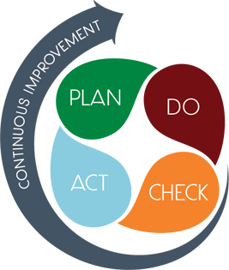
Connecting the Strategic plan & Continuous Improvement Plan
Increase academic achievement in ELA & Math
GMAS
Lvl 3 and up will increase from 17% to 20% and Lvl 2 and up will increase from 48% to 51%
Strategic Plan Priority
CIP SMART Goal
Key Indicator
Increase academic achievement in Math
Level 3 and up will increase from 13% to 16% and Lvl 2 and up will increase from 47% to 50%
GMAS
Implement Whole Child Support System
Increase ADA from 87.8% to 90%
EOY Average Daily Attendance (ADA)

Slide 8
Data Discussion

Slide 9
Spring MAP
Results

Slide 10
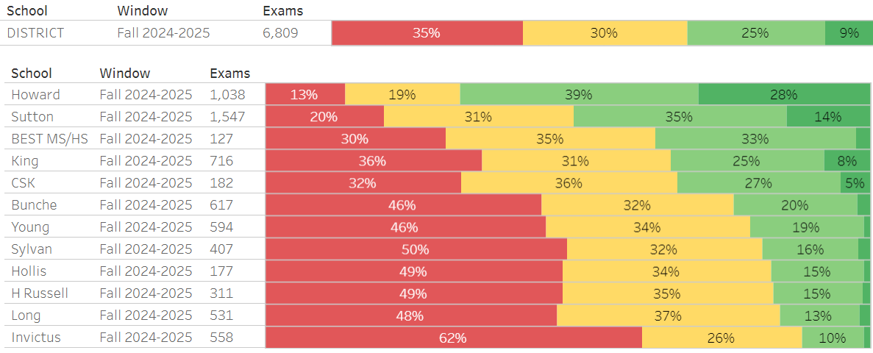
ELA MAP Achievement 2024-2025
ELA Grade Level Achievement

Slide 11
Subgroup Proficiency Data: ELA
SWD
ELL
Gifted

Slide 12
Are We Meeting Our Goals?
ELA
Grade | Level 2 and up ≥ 51% | Level 3 and up ≥ 20%
6th | 54% | 22%
7th | 49% | 15%
8th | 59% | 24%
School | 54% | 20%

Slide 13
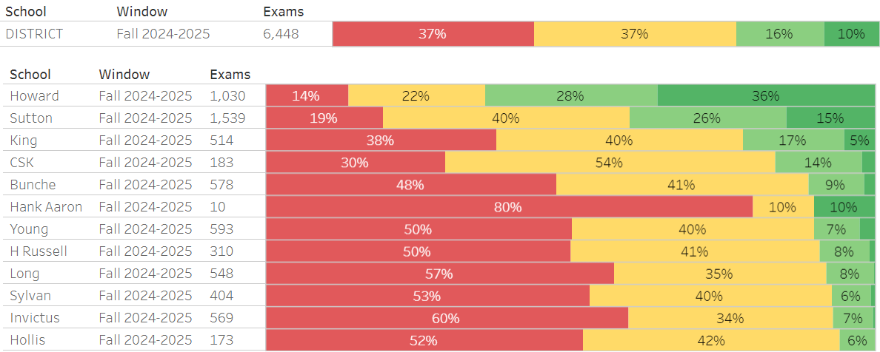
MATH MAP Achievement 2024 - 2025
Math Grade Level Achievement

Slide 14
Subgroup Proficiency Data: MATH
SWD
ELL
Gifted

Slide 15
Are We Meeting Our Goals?
Math
Grade | Level 2 and up ≥ 50% | Level 3 and up ≥ 16%
6th | 56% | 8%
7th | 45% | 13%
8th | 48% | 9%
School | 50% | 10%

Slide 16
Science MAP growth quintiles 2024-2025

Slide 17
Subgroup Proficiency Data: Science
SWD
ELL
Gifted

Slide 18
Are We Meeting Our Goals?
Science
Grade | Level 2 and up ≥ 31% | Level 3 and up ≥ 14%
8th | 43% | 22%

Slide 19
GMAS Results
Milestones Math results are embargoed by GA DOE until late September 2024. If you meet prior to the data being released, results will be shared at your next GO Team meeting.

Slide 20
ELA - School-Wide Georgia Milestones Assessment Data (GMAS)
Beginning
Developing
Proficient
Distinguished
Notes:
Wishes and Wows

Slide 21
Did We Meet Our Goals?
ELA
Level 2 and up ≥ 50% | Level 3 and up ≥ 20%
48% | 17%

Slide 22
Science - School-Wide Georgia Milestones Assessment Data (GMAS)
Beginning
Developing
Proficient
Distinguished
Notes:
Wishes and Wows

Slide 23
Social Studies - School-Wide Georgia Milestones Assessment Data (GMAS)
Beginning
Developing
Proficient
Distinguished
Notes:
Wishes and Wows

Slide 24
Students with Disabilities(SWD) GMAS Data
ELA
Science
S. Studies
Notes:
Wishes and Wows

Slide 25
English Language Learners (ELL) GMAS Data
ELA
Science
S. Studies
Notes:
Wishes and Wows

Slide 26
Glows & Grows
Glows
Grows
GMAS
6th and 8th grade showed improvement on both Math and ELA. Gains in 6th grade Math
SWD students showed improvement for both Math and ELA schoolwide.
MAP
ELA meeting/exceeding most EOY goals
Math meeting EOY schoolwide goal
GMAS
There were declines in 7th grade across the board as well as in 8th grade Social Studies.
MAP
ELA level 3 and up below target
Math all grades level 3 and up below target
are we on target to successfully ACCOMPLISH our priorities?
IMPACT

Slide 27
GO Team Discussion: Data Protocol
What do you notice?
What are your wonderings?
What additional questions do you have?

Slide 28
Timeline for GO Teams
You are HERE
Fall 2021
GO Team Developed 2021-2025 Strategic Plan
1
Summer
School Leadership completed Needs Assessment and defined overarching needs
2
August
School Leadership completed Continuous Improvement Plan
3
Sept. – Dec.
Utilizing current data, the GO Team will review & possibly update the school strategic priorities and plan
4
Before Winter Break
GO Team will take action (vote) on the rank of the strategic plan priorities for SY25-26 in preparation for budget discussions.
5

Slide 29
Questions?

Slide 30
Discussion: Optional School Uniform

Slide 31
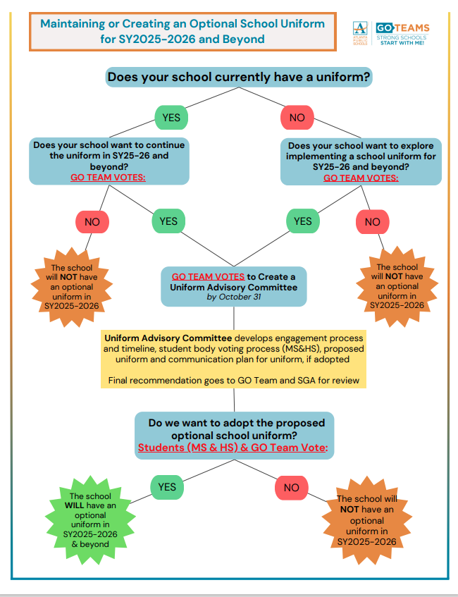

Slide 32
Optional School Uniform
In the 2023-2024 school year, the APS Board of Education updated the district’s dress code policy. As part of the update, starting with the 2025-2026 school year if a school wishes to maintain or explore implementing an optional school uniform, it must go through an engagement process and have a vote as outlined below:
Elementary
Middle
High
A school uniform is adopted upon the agreement of the principal and a majority vote of the School Governance Team (GO Team).
School uniforms are adopted upon the agreement of the principal, GO Team and the elected student government. If the school does not have an elected student government, then a majority vote must be secured from the student body to adopt a school uniform.
School uniforms are adopted upon the agreement of the principal, GO Team and the elected student government. If the school does not have an elected student government, then a majority vote must be secured from the student body to adopt a school uniform.
If your school currently has a school uniform and wishes to continue it, you must go through this process!

Slide 33
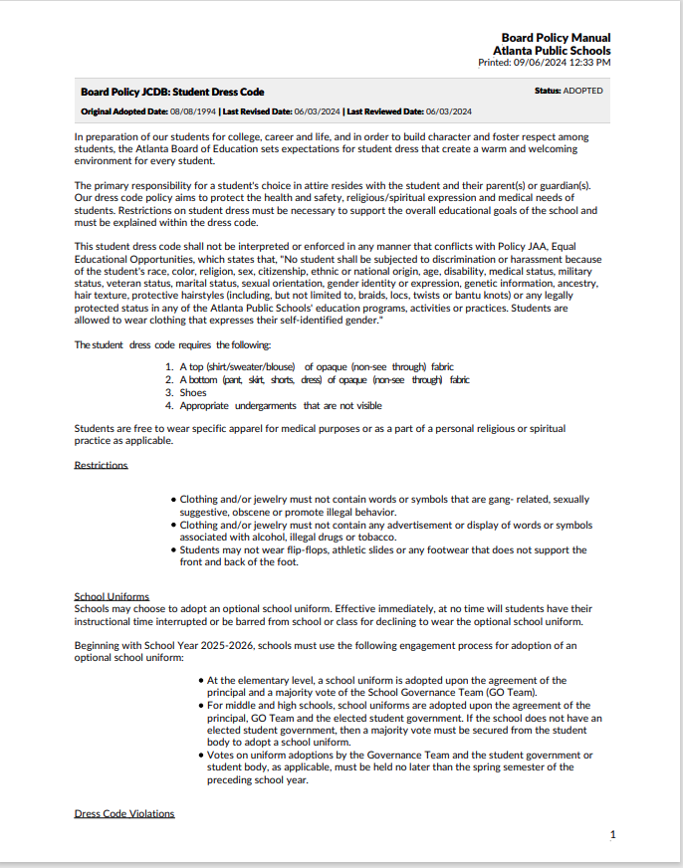
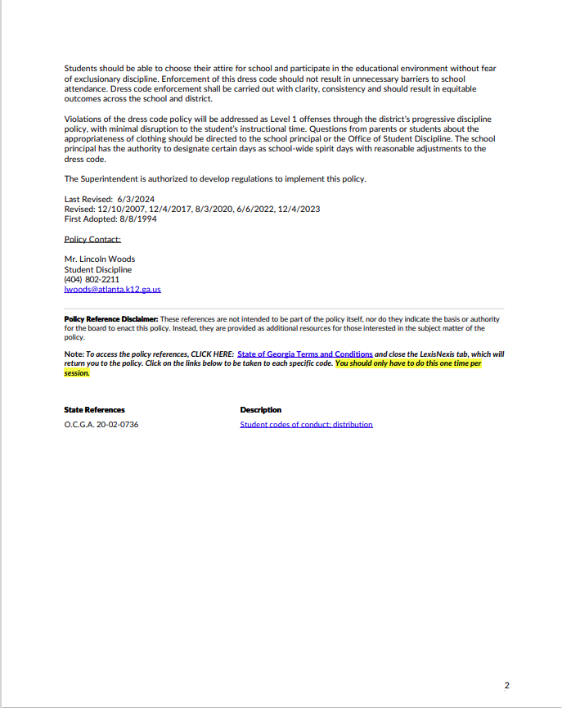

Slide 34
ABOE Policy JCDB Student Dress Code (Last Revised, 06/03/2024)
http://tinyAPS.com/?APSDressCodePolicy
Requirements
Restrictions
A top of non-see through fabric
A bottom of non-see through fabric
Shoes
Undergarments that are not visible
No words or symbols that are gang-related, sexually suggestive, obscene or promote illegal behavior
Nothing associated with alcohol, illegal drugs or tobacco
No flip-flops, athletic slides or footwear that doesn’t support the front and back of the foot

Slide 35
School-specific Dress Codes
We have one districtwide student dress code adopted
by the Atlanta Board of Education.
School-specific dress codes may not contradict Board policy.
Examples of problematic school specific dress-code provisions
“dress in good taste”
“no baggy pants”
“no short shorts or skirts”
“no tight/revealing clothing”
“no ‘extreme’ hairstyles or colors”
“all shirts must be tucked in
“hair should be clean and neatly groomed”
“no shirts which expose cleavage”
“students dressed in uniform are better perceived by teachers and peers”
“no activewear”
“no sweatpants”
“no spaghetti straps”
“no tube tops”
“no dresses”
“no leggings”
“no joggers”
“no Crocs”
“no hoodies/hooded jackets”

Slide 36
School Uniforms
Schools may choose to adopt an optional school uniform.
Effective immediately, at no time will students have their instructional time interrupted or be barred from school or class for declining to wear the optional school uniform.

Slide 37
Establish an optional school uniform
If your school currently has a school uniform and wishes to continue it, you must go through this process!
The GO Team needs to TAKE ACTION (vote) on maintaining or exploring implementing an optional school uniform.
After the motion and a second, the GO Team may have additional discussion. Once discussion is concluded, the GO Team will vote.
If the GO Team votes to move forward, then the team should proceed to discuss the School Uniform Advisory Committee.
Take Action

Slide 38
DISCUSSION
Only needed if the GO Team voted YES to maintaining or exploring establishing an optional school uniform.
The GO Team will now discuss if they wish to move forward with establishing a School Uniform Advisory Committee.
The School Uniform Advisory Committee will be responsible for:
Develop a stakeholder engagement plan to receive feedback on implementing a uniform and its components, if adopted. Must include a minimum 20-day public comment period on any proposed uniform
Recommending the optional school uniform components.
Establishing the student voting timeline and process (if necessary).
Determine the length of time the uniform will be in use before reconsideration
Developing a communication plan to inform the school community about the optional school uniform, if the uniform is adopted
Other objectives as defined by the GO Team.

Slide 39
Committee members
Only needed if the GO Team voted YES to maintaining or exploring establishing an optional school uniform.
The GO Team will also need to determine who will be on the committee:
The GO Team Chair will name the Committee Chair.
No more than 2 additional GO Team members may be on the committee (a maximum of 3 GO Team Members).
Committee must have at least 3 students as outlined below:
Other committee members may be added, as determined by the GO Team.
Elementary
Middle
High
Elementary School with Ambassadors Recommend inclusion of at least 3 student ambassadors
Elementary School without Ambassadors
Recommend inclusion of at least 3 students selected by the principal with GO Team input
Middle School with Student Ambassadors
At least 3 student ambassadors
Middle School without Student Ambassadors
At least 3 students selected by the principal with GO Team input
High School with Elected Student Government
At least 3 students as selected by the SGA
High School without Elected Student Government
At least 3 students as selected by the principal with GO Team input

Slide 40
Establish the Committee
Only needed if the GO Team voted YES to maintaining or exploring establishing an optional school uniform.
The GO Team needs to TAKE ACTION (vote) on establishing its School Uniform Advisory Committee based on the previous discussion.
After the motion and a second, the GO Team may have additional discussion.
Once discussion is concluded, the GO Team will vote.
If the GO Team votes in the affirmative (yes) for moving forward, then the Chair will need to fill out a committee resolution form (see example on next slide) and send to the GO Team Office.
Take Action

Slide 41
Blank Committee Resolution

Slide 42
Principal’s Report

Slide 43
Young Middle School Leveling and fy25 budget adjustment
Date

Slide 44
Enrollment
Projected Enrollment | 649
15-Day Count(08.21.24) Enrollment | 632
Difference | -17
Leveling
Leveling is the process the District uses to adjust school budget allocations to match student enrollment.
Budget Adjustment* | $-90,678
*The budget adjustment reflects the impact of the following: enrollment changes, FY25 reserve, adjustments to Title I, Family Engagement and School Improvement Allocations, Security Grants and FY24 carryover funds
Notes:
Principals: Based on your15-Day count, please give your GO Team an overview of your projected vs. 8/21 enrolled numbers as well as information on your FY25 budget adjustment.

Slide 45
Plan for FY25 Leveling Reserve
$ 50,537
Priorities | APS FIVE Focus Area | Strategies | Requests | Amount
Increase level of rigor and relevance (example- please remove) | Fostering Academic Excellence for All (example- please remove) | Implementation of guided reading training for all staff (example- please remove) | Purchase an additional Teacher (example- please remove) | $84, 134 (example- please remove)
**Used to offset $90,678 deficit
Notes:
Review the previously discussed plan for the FY25 Leveling Reserve as discussed by the GO Team in your Feb. 2024 Budget Feedback meeting and March 2024 Approval meeting.

Slide 46
Plan for FY25 Title I Holdback
$2,873
Priorities | APS FIVE Focus Area | Strategies | Requests | Amount
Increase level of rigor and relevance (example- please remove) | Fostering Academic Excellence for All (example- please remove) | Implementation of guided reading training for all staff (example- please remove) | Purchase an additional Teacher (example- please remove) | $84, 134 (example- please remove)
EXAMPLE
**Used to offset $90,678 deficit
Notes:
Review the previously discussed plan for the FY25 Title I Holdback as discussed by the GO Team in your Feb. 2024 Budget Feedback meeting and March 2024 Approval meeting.

Slide 47
Summary of Changes As A result of FY25 Budget Adjustment
Personnel Changes | Non-Personnel Changes
SPED Teacher (per SPED leveling) | * NA – Balanced after offsets from reserves & Title I holdback
Summary of Changes
There is little to no impact to the school’s strategic plan, as the personnel and non-personnel changes were minimal.

Slide 48
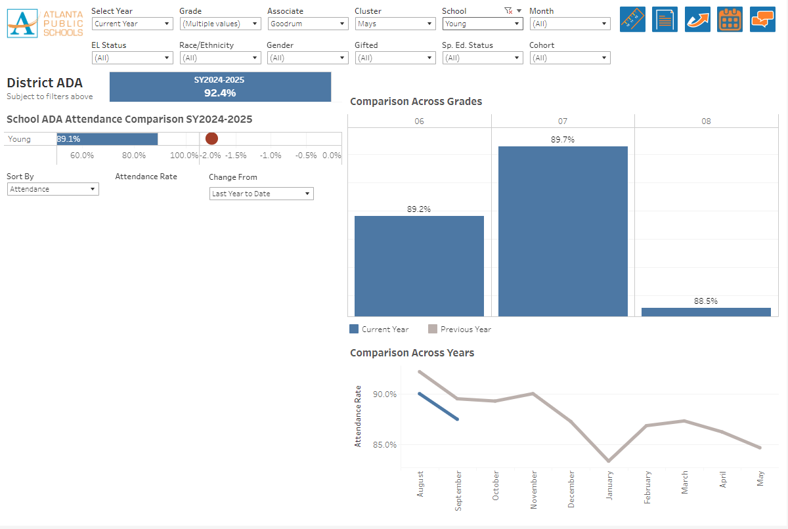
Information about our school

Slide 49
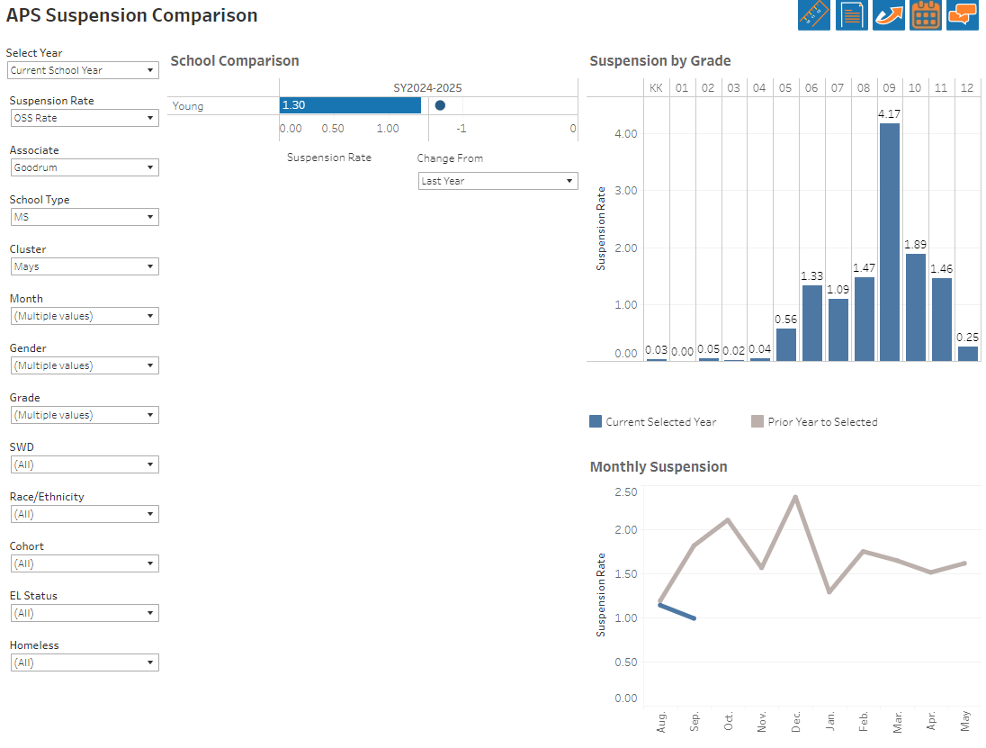
Information about our school

Slide 50
Information about our school

Slide 51
Join us on Saturday, September 28 All GO team members are invited, but plan to have at least 3 members of your GO Team attend!

Slide 52
Questions?

